Slide 1

Cyber Threat Intelligence
Module 4.3
MIS 689
Cyber Warfare
Capstone

Slide 2
Exploring AZSecure Hacker Assets Portal: Identifying Threats, Actors, and Targets (Samtani, et al., JMIS, 34(4), 2017)

Slide 3
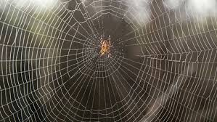

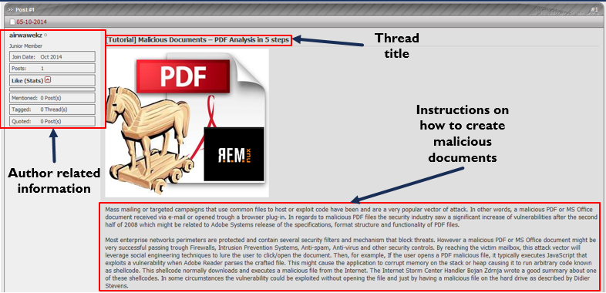
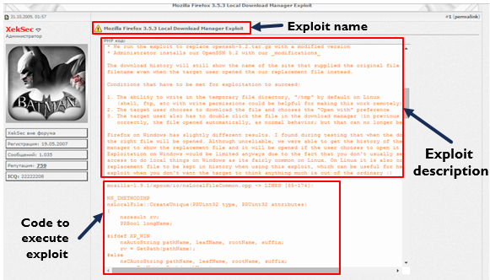
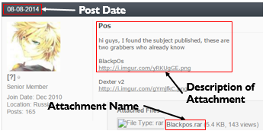

Hacker Asset Examples
Hackers and Hacker Assets
Tutorial on how to create
malicious documents
Forum post with source code to
exploit Mozilla Firefox 3.5.3
Forum post with
BlackPOS malware attachment.

Slide 4
Introduction – Hacker Asset Examples
Figure 1. Forum post with source code to create botnets
Figure 2. Forum post with BlackPOS malware attachment
Figure 3. Tutorial on how to create malicious documents

Slide 5

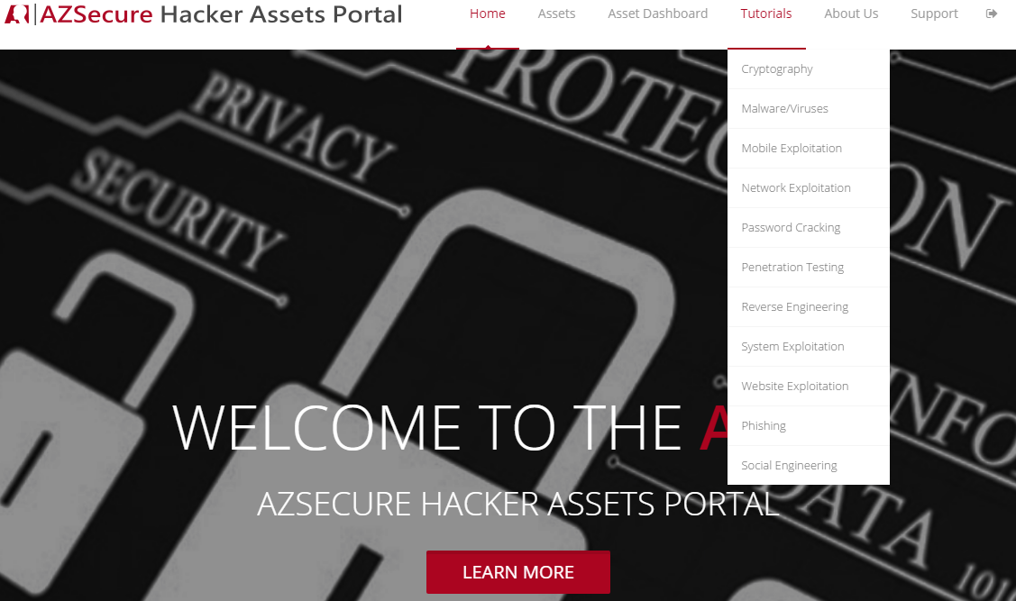



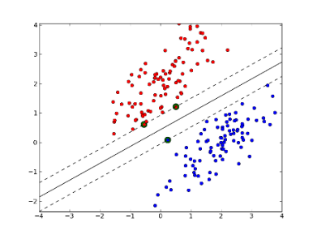
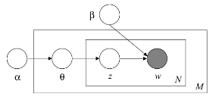

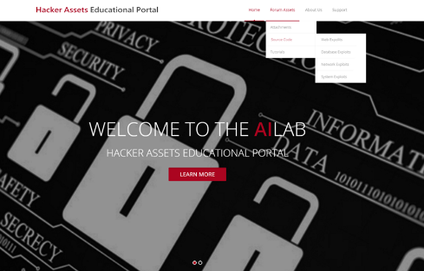
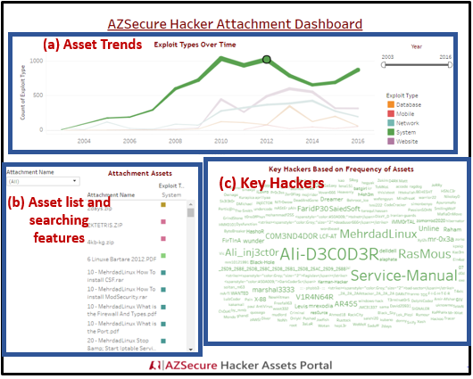
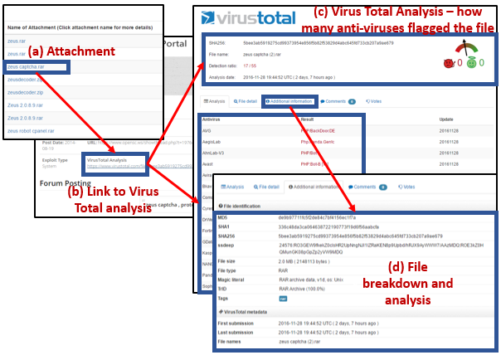
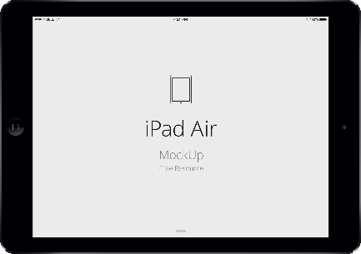
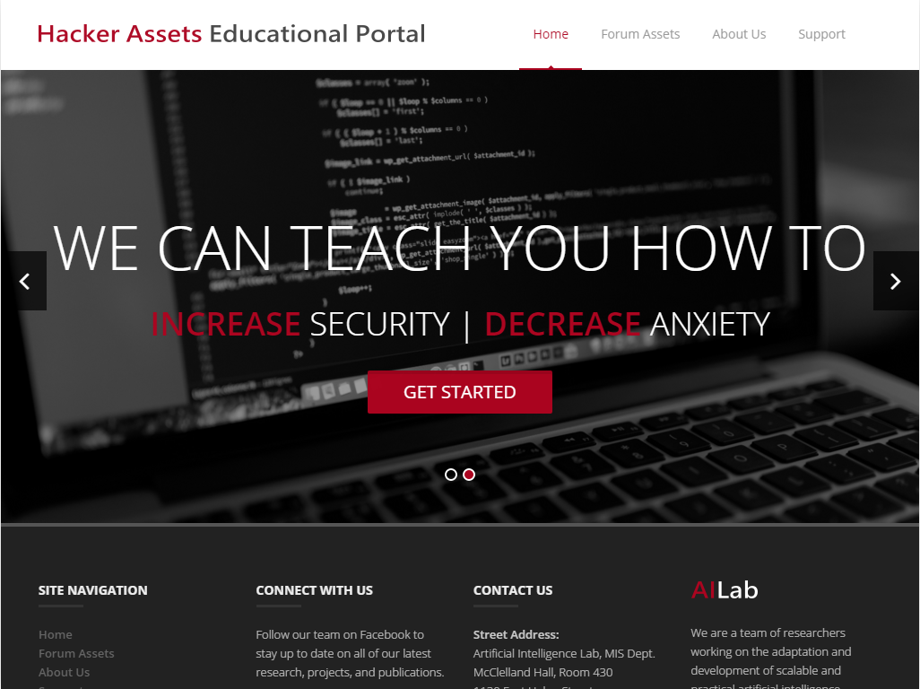

AZSecure Hacker Assets Portal System Design and Features
Data Collection and Analytics
Web Hosting and Access
System Functionalities
Browsing
Searching
Downloading
System Analytics
Latent Dirichlet Allocation (LDA) and
Support Vector Machine (SVM) Analytics
987 tutorials, 15,576 source code, and
14,851 attachments
Cyber Threat Intelligence
Dashboard
VirusTotal Malware Analysis
Figure 5. AZSecure Hacker Assets Portal System Design and Features

Slide 6
AZSecure Hacker Assets Portal – Data Testbed
Forum | Language | Date Range | # of Posts | # of Members | # of source code | # of attachments | # of tutorials
OpenSC | English | 02/07/2005-02/21/2016 | 124,993 | 6,796 | 2,590 | 2,349 | 628
Xeksec | Russian | 07/07/2007- 9/15/2015 | 62,316 | 18,462 | 2,456 | - | 40
Ashiyane | Arabic | 5/30/2003 – 9/24/2016 | 34,247 | 6,406 | 5,958 | 10,086 | 80
tuts4you | English | 6/10/2006 – 10/31/2016 | 40,666 | 2,539 | - | 2,206 | 38
exelab | Russian | 8/25/2008 – 10/27/2016 | 328,477 | 13,289 | 4,572 | - | 628
Total: | - | 02/07/2005- 10/31/2016 | 590,699 | 47,492 | 15,576 | 14,851 | 987
Notes:
The Data Mining slide needs to have a system diagram, testbed, and validation results – some significant details to lend credibility.

Slide 7
AZSecure Hacker Assets Portal – Data Mining Approach
Algorithm | Accuracy | Precision | Recall | F1
SVM | 98.20 | 96.36 | 98.20 | 98.28
k-Nearest Neighbor | 64.00 | 83.47 | 64.00 | 72.24
Naïve Bayes | 86.00 | 88.57 | 86.00 | 87.26
Decision Tree | 82.60 | 86.41 | 82.60 | 84.42
Notes:
The Data Mining slide needs to have a system diagram, testbed, and validation results – some significant details to lend credibility.
Benchmarking in this fashion is a commonly accepted evaluation practice in computer science and related domains.

Slide 8
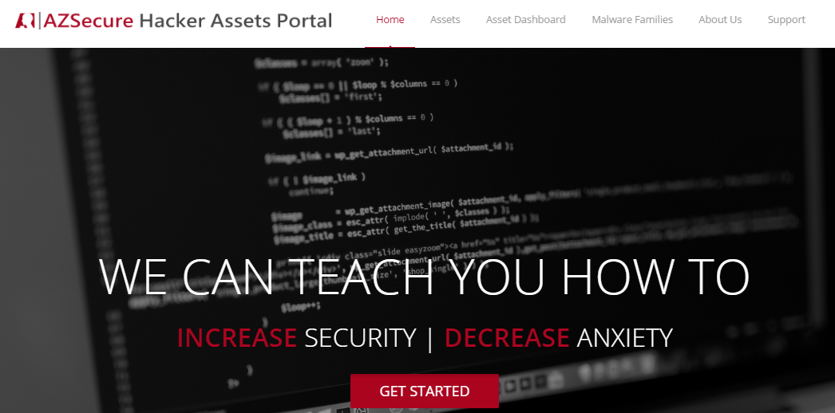
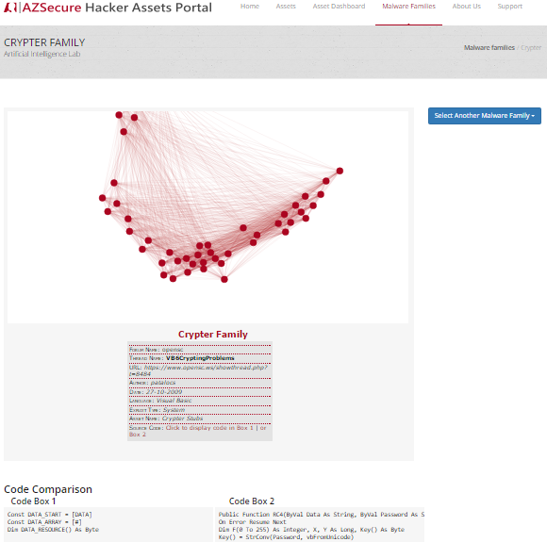
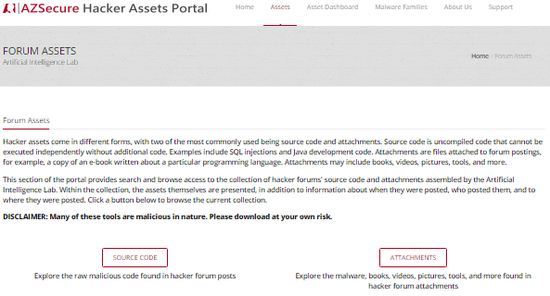
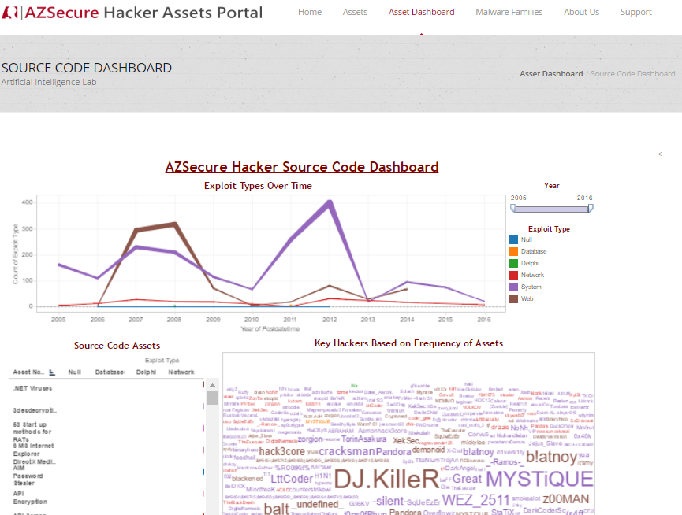
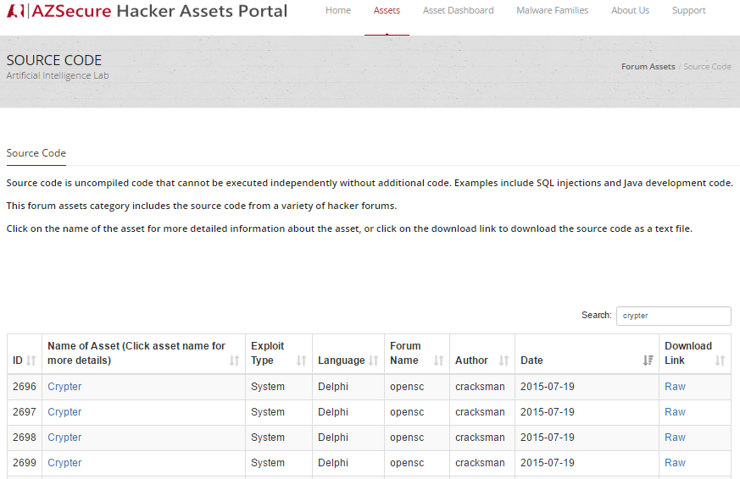
Hacker Assets Portal V2.0 – Overview
(a) Home page, linking to (b & c) Assets, (d) Dashboard, and (e) Malware Families:
(e) Malware Families, for depicting relationships among assets over time (Crypter Family shown)
(b) Assets page, linking to Source Code and Attachments
(c) Source Code page; sortable by asset name, exploit type, date, etc.
(d) Dashboard for drill-down analysis of hackers & assets over time

Slide 9
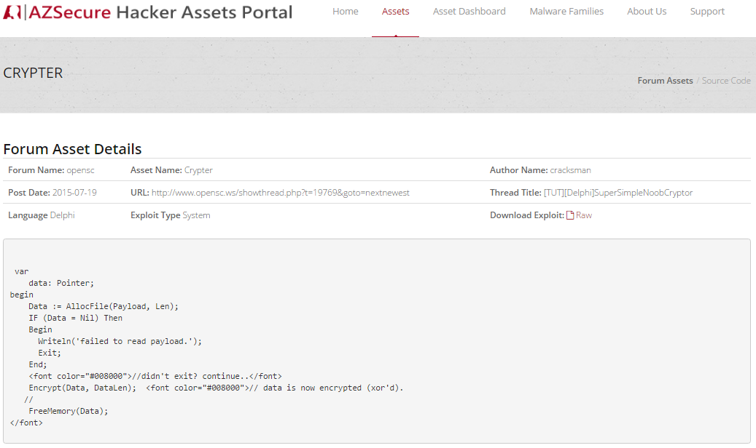
Searching, Sorting & Browsing Hacker Assets
(d) Browsing: Asset metadata and forum link
(a) Searching
(b) Sorting
(e) Browsing: Raw Code
(c) Browsing

Slide 10
Cyber Threat Intelligence (CTI) Dashboard
Notes:
Please add one slide illustrating how the hacker assets can help SFS students and other professionals in gaining knowledge about proactive threat intelligence and future defense. Illustrate actual utilities for good guys via some examples.
The Malware example needs to show how for cyber defense. You can select and download but so what? What do I learn to defend my assets, e.g., types of vulnerability, system?

Slide 11
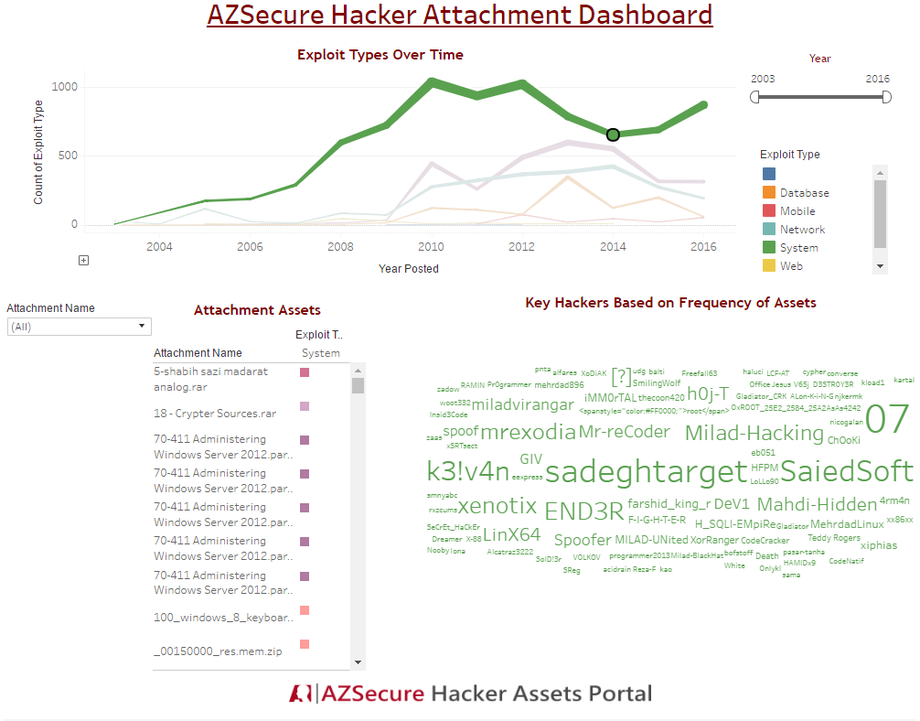
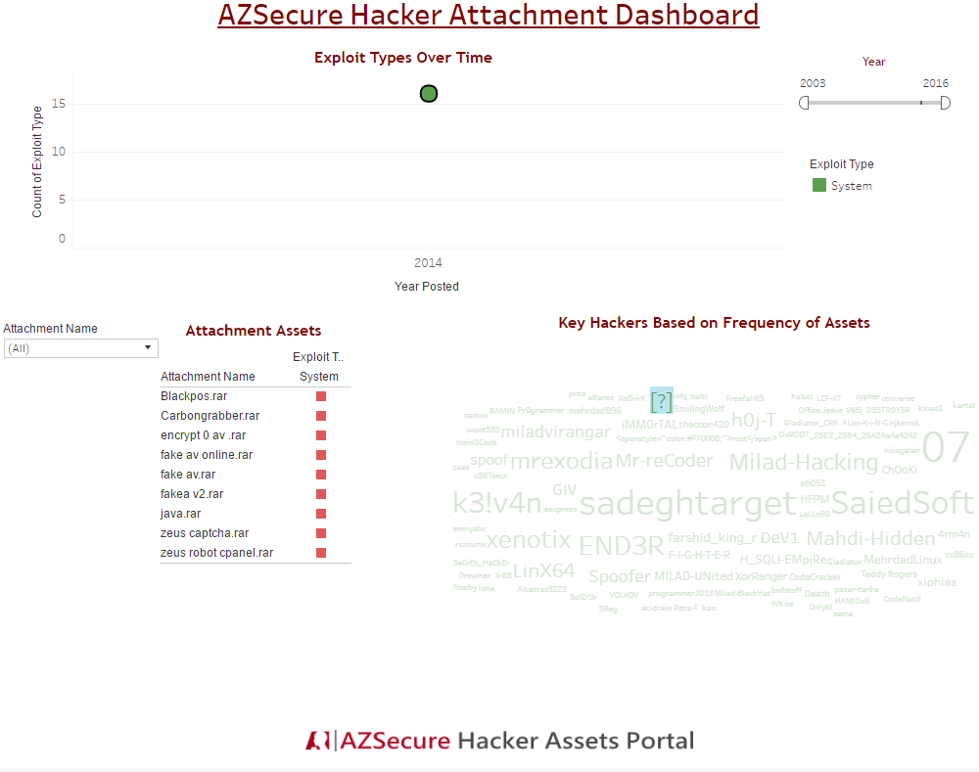
Cyber Threat Intelligence (CTI) Example – Bank Exploits
1
2
Filtering on 2014, when BlackPOS was posted, shows assets and threat actors at that time.
Filtering the actor who posted BlackPOS reveals that he posts other bank exploits (e.g., Zeus).
Provides intelligence on which hacker to monitor.

Slide 12
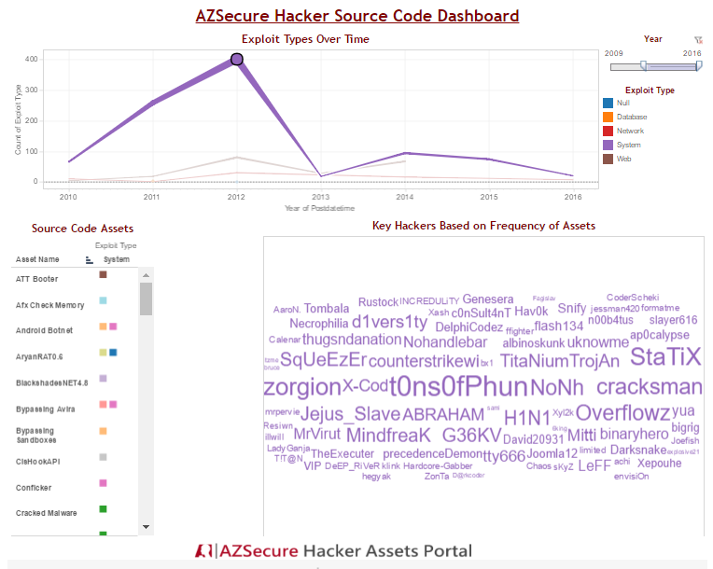
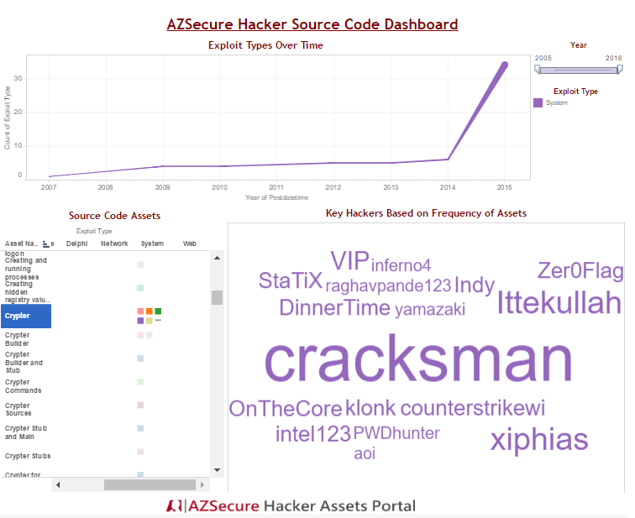
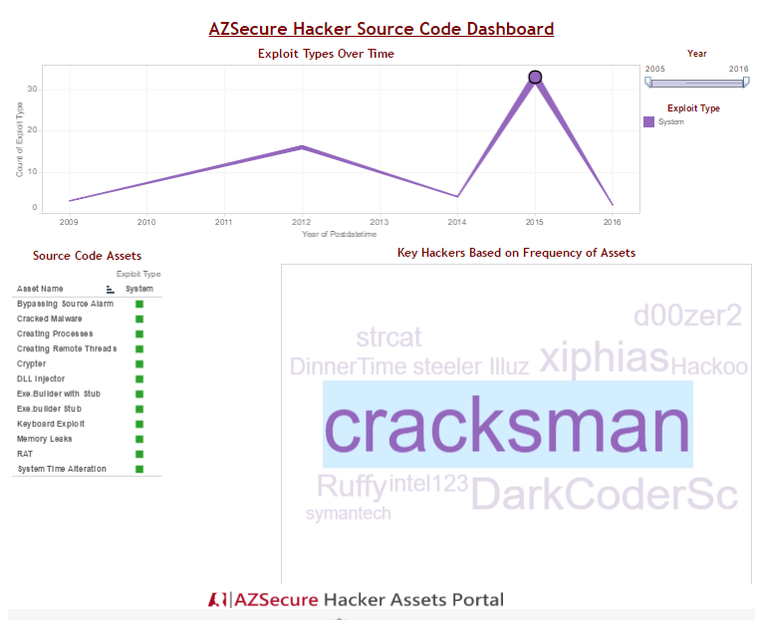
Cyber Threat Intelligence (CTI) Example – Crypters
1
2
3
Filtering on a specific time point (highest peak):
Filtering on a specific asset (crypters, a key technology for Ransomware)
Filtering a specific crypter author (Cracksman) shows the trends and types of assets he posted.

Slide 13
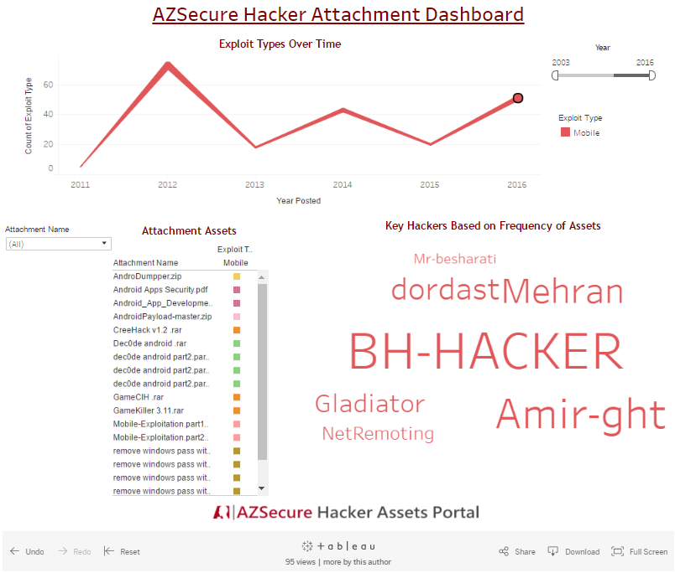
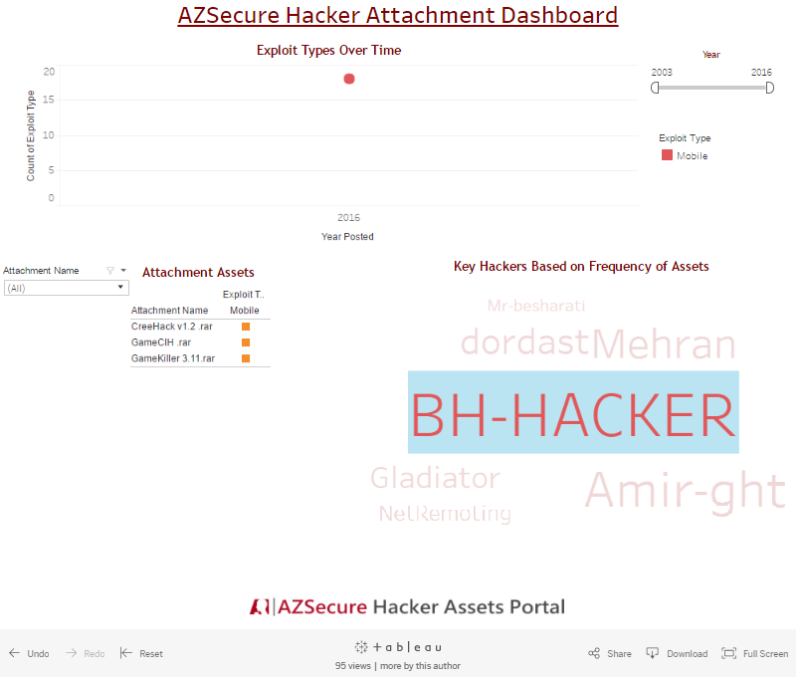
Cyber Threat Intelligence (CTI) Example – Mobile Malware
1
2
Filtering for 2016 mobile malware shows assets and threat actors at that time.
Filtering on a specific actor (BH-HACKER) allows us to see the assets posted.

